Slide 1
Mac Acquisitions
Basic Investigations of Computers and Electronic Crimes Program (BICEP)

Slide 2

Sumuri Recon ITR

Slide 3

Sumuri Recon Imager

Slide 4

Sumuri Recon ITR – T2 Mac

Slide 5
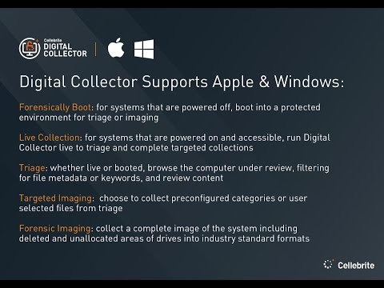
Cellebrite Digital Collector

Slide 6

Cellebrite Digital Collector – Silicon Mac

Slide 7
Questions?

